Slide 1

How to Really Use
Grammarly

Slide 2
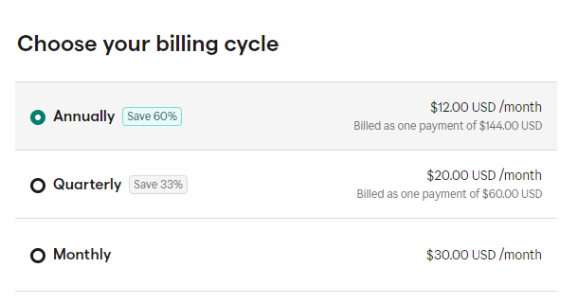
Upgrading to Premium
Notes:
https://www.grammarly.com/upgrade

Slide 3
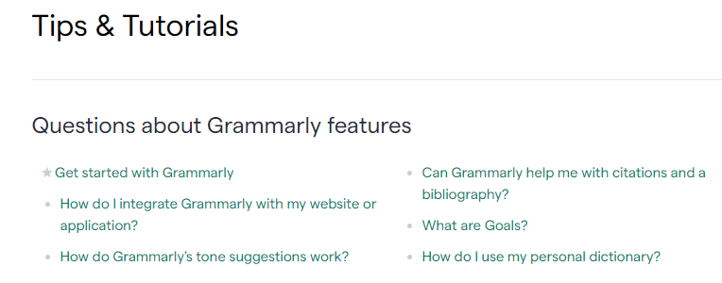
Getting More Information
Notes:
https://support.grammarly.com/hc/en-us/categories/115000018631-Tips-Tutorials

Slide 4

Understanding the Editor

Slide 5
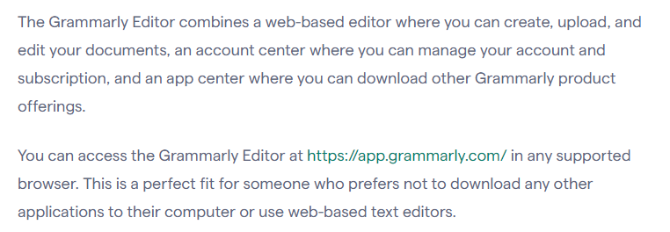
Notes:
https://support.grammarly.com/hc/en-us/articles/360003474732-Grammarly-Editor-user-guide

Slide 6
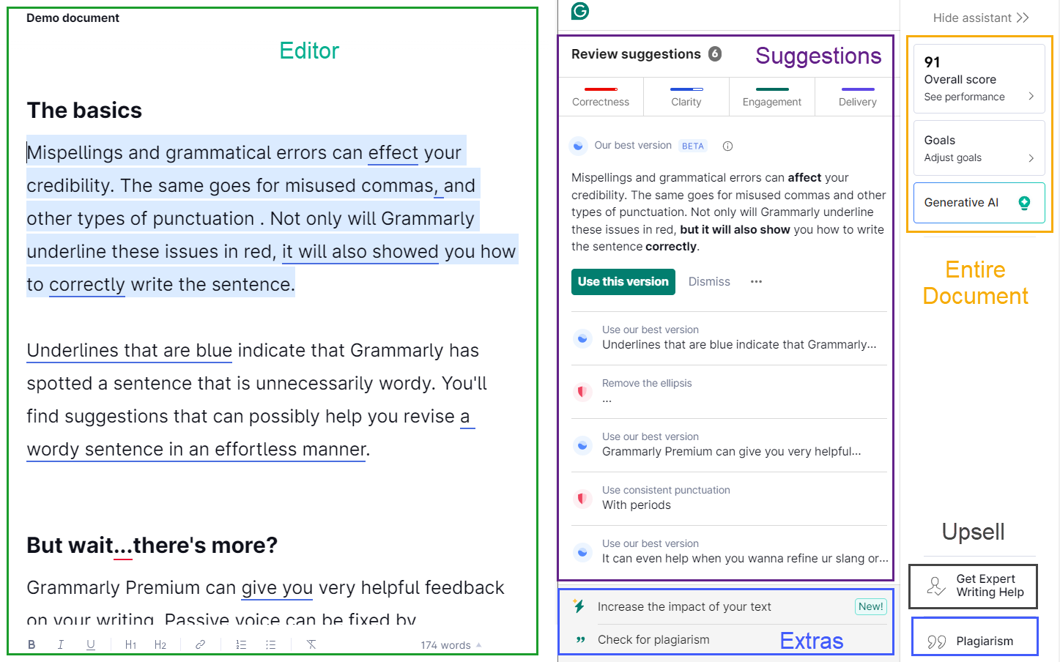
Notes:
https://app.grammarly.com/

Slide 7
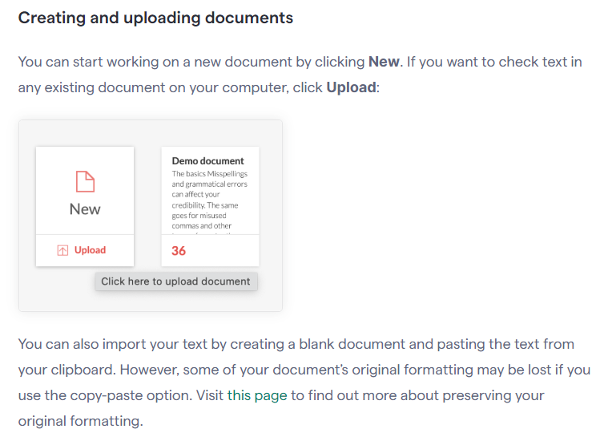
Notes:
https://support.grammarly.com/hc/en-us/articles/360003474732-Grammarly-Editor-user-guide

Slide 8
Downloading Documents
Notes:
https://support.grammarly.com/hc/en-us/articles/360003474732-Grammarly-Editor-user-guide

Slide 9
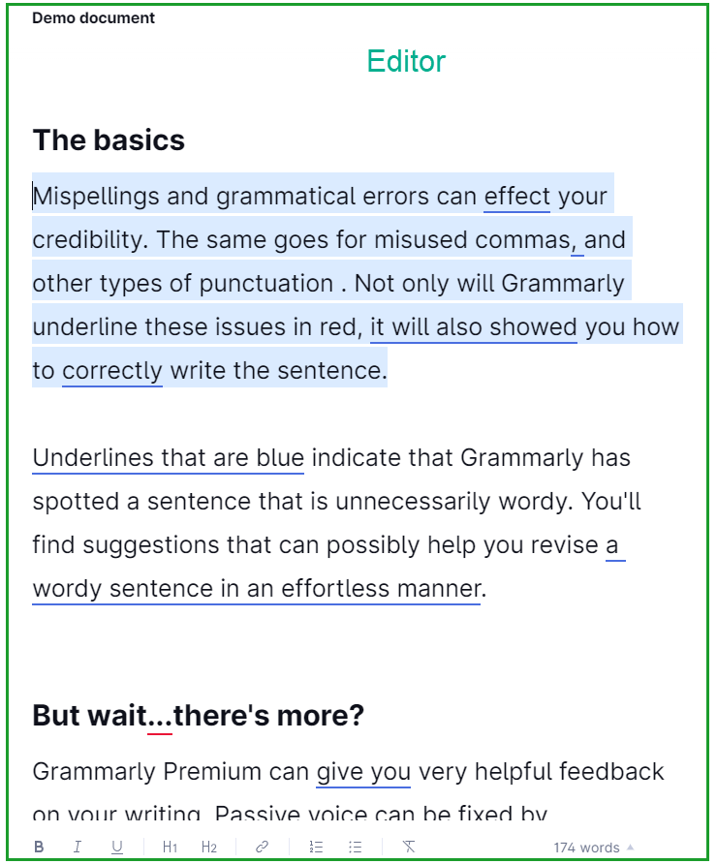
Editor

Slide 10
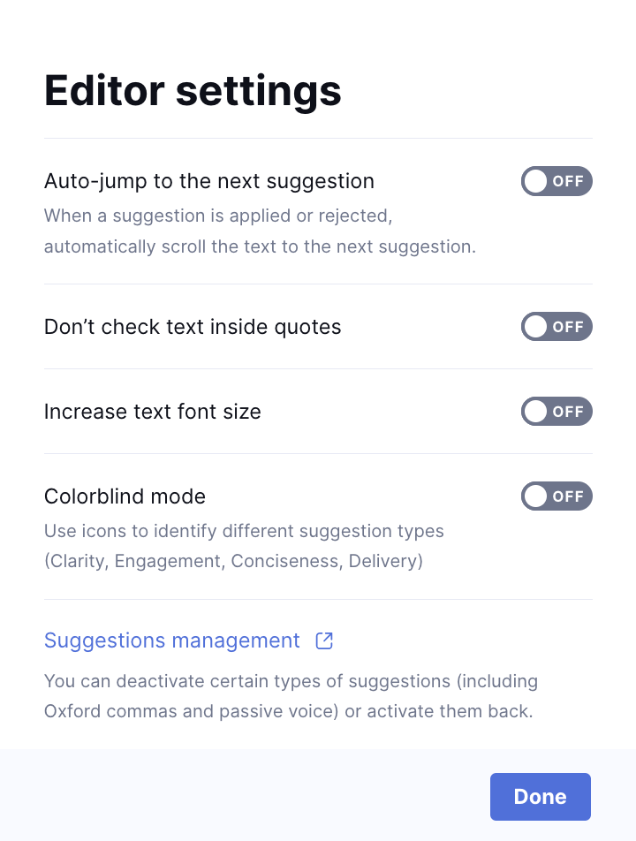
Editor Settings

Slide 11
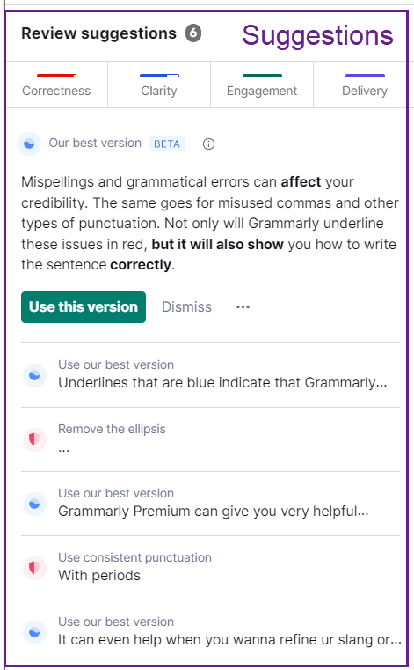
Suggestions

Slide 12
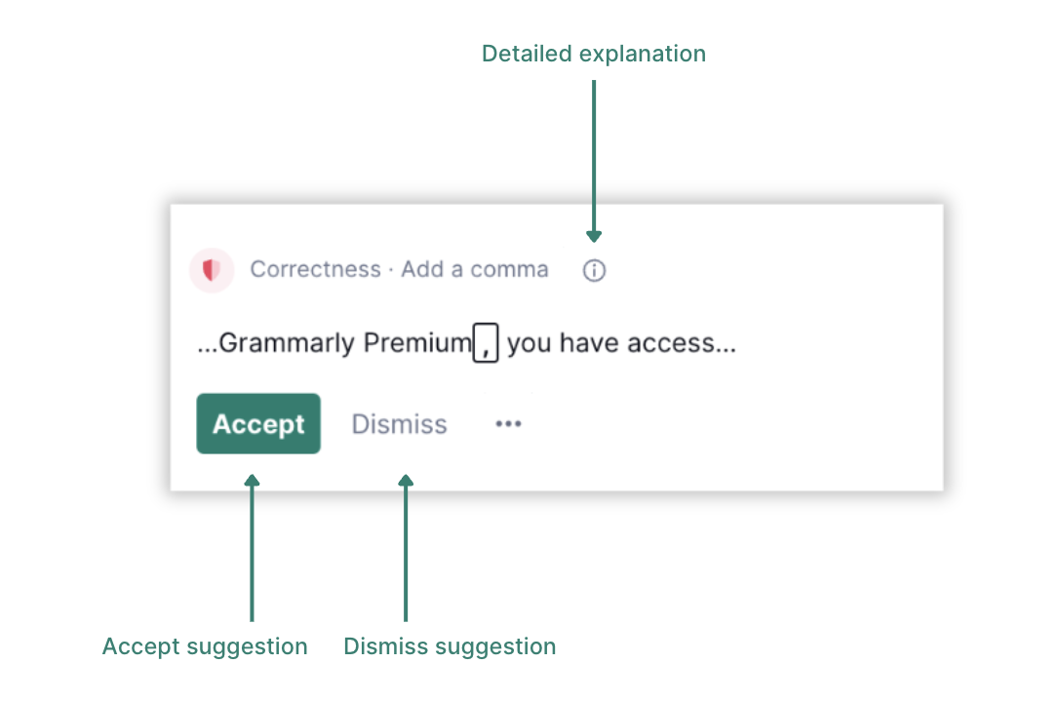
Suggestion Options
Notes:
https://support.grammarly.com/hc/en-us/articles/360003474732-Grammarly-Editor-user-guide

Slide 13
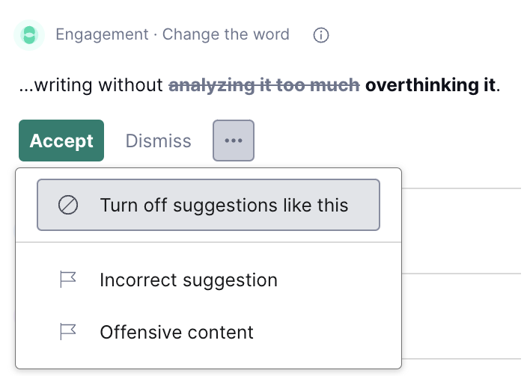
Turning Off Certain Suggestions
Notes:
https://account.grammarly.com/customize/suggestions

Slide 14
Using Your Personal Dictionary

Slide 15




Notes:
https://www.youtube.com/channel/UC35ZpwldGw7ZJ5R-2sLijzw

Slide 16


Membership has its privileges
Notes:
https://www.youtube.com/channel/UC35ZpwldGw7ZJ5R-2sLijzw/join

Slide 17

https://www.youtube.com/@AINewsFresh

Slide 18


